Slide 1
Creativity & Innovation
BM006-3-2-CRI (VC1) 1st April 2018
Lecture 9:
Intellectual Property

Slide 2
Topic Learning Outcomes
To demonstrate critical understanding of well-established concepts, principles and their development in intellectual property.

Slide 3
The IP Chain of Activities
Creation
Innovation
Commercialization
Protection
Enforcement

Slide 4
Intellectual property
Copyright
Industrial Property
a.Trademarks
b. Patent
c. Industrial designs
d. Confidential information
E Geographical Indications

Slide 5
IP as intangible property
Tangible property
Land, houses, estates,car
Intangible property
-intellectual property
Intangible wealth, easily appropriated and reproduced,once created the marginal cost of reproduction is negligible

Slide 6
The role of IP as intangible property
1. economic rights of creators
2.commercial exploitation of owner of IP
3.capital expenditure
4.transfer of technology
5.cultural development

Slide 7
Why IP protection is given
Capital expenditure for new products
R and D
Marketing and advertisement
No free loaders
Maintaining loyal followers
profit

Slide 8
IP as a property
Can be sold
Can be bought
Can be lease or rent
Can pass under a will
Can be assigned

Slide 9
The Legal Framework for IP
MyIPO is the legal custodian.
Three machinery of administration
- the IP office
- the external machinery
- the court

Slide 10
International Convention for IP
Paris Convention for Protection of Industrial Property 1967 ( 1989)
Berne Convention for the Protection of Literary and Artistic Works 1971 ( 1990)
Trade-related aspects of Intellectual Property Agreement 1994 ( 1995)
WCT ( digital agenda)
PCT 2004

Slide 11
Paris Convention
Protection for industrial property
Trade mark
Patent
Unfair competition
Governed by domestic legislation

Slide 12
Berne Convention
Protection of literary and artistic work
Governed by national legislation

Slide 13
Wipo Copyright Treaty
Digital agenda.
Technological measures such as circumvention of technological maesures.

Slide 14
TRIPS 1994 (1995)
Additional to Paris and Berne.
Minimum requirement.
Most favoured nation treatment.
Strong enforcement procedure.

Slide 15
Patent Cooperation Treaty (PCT)
Making it easier to make paten application
Designated country.
International phase to national phase.

Slide 16
Basic principle of international convention
Laying down the minimum requirement for the national legislation.
“members may but shall not be obliged to implement more extensive protection in their law than is required by the agreement. TRIPS 1(1)

Slide 17
The principle of national treatment
“Each members shall accord to the nationals of other Members treatment no less favourable than it accord to its own national”

Slide 18
Obligation of convention
State to state
Not open to individual.
Example : India v USA.

Slide 19
The Laws For Intellectual Property Protection
Copyright Act 1987
Trademarks Act 1976
Patent Act 1983
Industrial Design Act 1996
Geographical Indications Act 2000
Law of Tort
-passing-off
Confidential information

Slide 20
Protection for Copyright
Protection given by law for a term of years to the composer, author etc… to make copies of their work..
Work include literary, artistic, musical,films, sound recordings,broadcasts.
Commercial and moral rights.
No registration provision.

Slide 21
Protection for trade marks
Commercial exploitation of a product
To identify the product, giving it a name
“mark” includes a device, brand, heading, label, ticket, name, signature,word, letter, numeral or any combination.
Does not include sound or smell

Slide 22
Trade marks (cont.)
Can either be registered or not registered
Advantages of registered trade marks
Application can be made for goods and services
Perform certain function such as indication of quality,identifying a trade connection

Slide 23
Choosing the correct mark
Compare the trade mark “Dove” to using the mark “crows”.
Would the “Frog restaurant ” be acceptable?
Would Marksman and Weekend Sex be acceptable?

Slide 24
Protection for patent
Basic idea of granting a patent
“ the applicant applied to the government for the right of patent and in return for the monopoly given he must disclose everything about the invention in the patent document” ( the description)
Duration 20 years.

Slide 25
Patent (cont.)
Patent for invention
Patent can be applied for a product or a process.
Patentable invention must be new,involves an inventive step and industrially applicable
Priority date- first to file

Slide 26
The role of patent
Innovation
Anticipating the changes that is coming
- Kodak
- Polaroid
- Haeir

Slide 27
The various route for application
The national route
The Paris route
The PCT route

Slide 28
Protection for industrial designs
Protection for industrial designs that are new or original
Design are feature of shape, configuration, pattern or ornament
The design must be applied to an article
The design must be applied by an industrial process.
Appeal to the eye.

Slide 29
Commercialization strategies
Novelty
Effect of failure to register before marketing

Slide 30
Protection for geographical indications
Meaning “ an indication which identifies any goods as originating in a country or territory, or a region or locality where a given quality, reputation or other characteristic of the goods is essentially attributable to their geographical origin”

Slide 31
Protection for geographical indication
Product must come from a particular geographical territory
Uses a name link to the particular geographical nature of the territory
Such as labu sayung from the sayung Perak,
Batik Trengganu,batik Kelantan etc.
To stop others from using

Slide 32
Examples of GI
Swiss made
Swiss chocolates
Sarawak pepper
Salted egg
Sweet tamarind

Slide 33
Protection under the law of Tort
Based on common law
There is no legislation pass by Parliament
Enforced by court’s decision.
Strict application of precedent.

Slide 34
Passing-off
For trade mark ( registered and unregistered)
Started from the tort of deceits.
The deceiver, the audience and the victim.
Requirement of “goodwill”

Slide 35
Confidential information
Protection under the law of tort
Protection for confidential information under contract, employer-employee relationship,husband and wife,etc
Need to show:-
- information are confidential
- recipient who obtained the information uses it
- damages suffered by the owner

Slide 36
Illustration
Customers list
Secret recipes
Smells of a new perfume

Slide 37
Qualification for protection of Intellectual property in Malaysia.
Protection are territorial.
Procedural requirement must be met.
Intellectual Property Corporation Malaysia act as the governing body.
Forms submitted,search made,prescribe time period observed.
Abiding to International Convention.

Slide 38
Duration of protection
Life + 50
50
20
15
10
Payment of statutory fee.

Slide 39
Ownership
Who is the owner?
Proper plaintiff rule.
-employer and employee relationship
- independent contractor.
- government employee.
- joint-ownership.
Commissioned works

Slide 40
Exclusive rights
To control the whole or a substantial part of the work.:-
the reproduction in any material form.
The communication to the public.
The public performance,showing or playing
Distribution by sale or other transfer
Commercial rental to the public.

Slide 41
The exception to the exclusive right
Fair dealing exception
Statutory exception under section 13(2)
Temporal ( duration)
Geographic
Non-material works
Compulsory licenses

Slide 42
Enforcing IP rights
civil action
Criminal prosecution
Cost in litigation
Assistance from Enforcement Division
Being vigilant/ self help

Slide 43
Civil action
Starting a civil action
Advantages
Liability for cost
Monetary compensation in term of damages

Slide 44
Criminal prosecution
Making a complaint
Police or enforcement division
Cost borne by the government
No monetary compensation
Remedy in term of fines or imprisonment for the offender

Slide 45
IP infringement
Primary infringement
- who does or causes
-making the product
Secondary infringement
- commercial activities
- selling,distribution for sale etc

Slide 46
Secondary infringement
sells,lets for hire or by way of trade exposes or offer for sale or hire any infringing copies.
Distribute infringing copies.
Importing into Malaysia

Slide 47
Commercialization
Assignment
Licenses
- exclusive
- non-exclusive

Slide 48
Intellectual property awareness in Malaysia
Only 20 % of IP rights such as in patent, trade marks are owned by Malaysian.
80 % are owned by foreigners.

Slide 49
MyIPO proactive measures
Special assistance for GI.
- Labu sayung
- kain Pua Sarawak
- Batik Kelantan
- Batik Trengganu
- Tenun Kelantan
- Tenun Trengganu

Slide 50
Question and answer session
Q & A
Slide <<number>> of 13

Slide 51
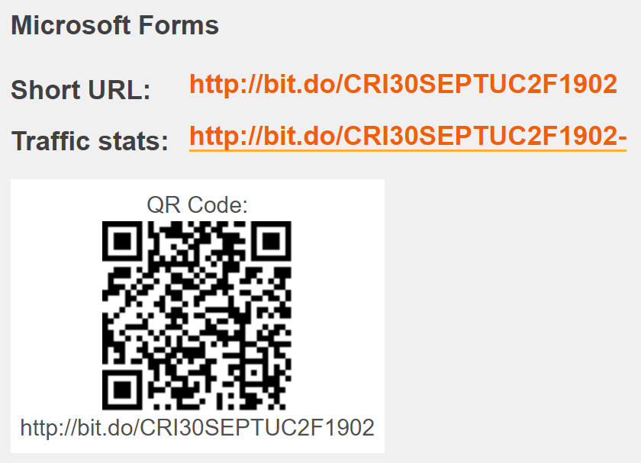


Slide 52
What we will cover next
Technical entrepreneurs
Slide <<number>> of 13

Slide 53
Activities
https://www.darts-ip.com/cases/case-country-year/malaysia/2017?creative=236271194046&keyword=&matchtype=b&network=g&device=c&gclid=EAIaIQobChMI1YHK7pWB4wIVhRWPCh0bgAGNEAAYASAAEgKegfD_BwE
Select one of the cases from the site and discuss the issues in relation to intellectual property perspectives

Slide 54
Top 10 copyright cases
https://www.copyright.com/blog/copyright-law-in-2018-top-10-court-cases/
1.https://www.computerworld.com/article/2560599/microsoft-fined--32m-by-south-korea-in-antitrust-case.html
2. https://www.theverge.com/2018/6/27/17510908/apple-samsung-settle-patent-battle-over-copying-iphone

